Slide 1


Design and Analysis of Class EF2 Inverter
Under the supervision of :
Presented By:
Prof. Rajeev Kumar Singh
Department of Electrical Engineering
Ankit Singh(23084003)

Slide 2
Outline of Presentation
Introduction
CLASS EF2 INVERTER: OVERVIEW
CIRCUIT COMPONENTS AND OPERATION
MATHEMATICAL ANALYSIS AND DESIGN EQUATIONS
SIMULATION RESULTS
Conclusion

Slide 3
Introduction
The increasing demand for energy-efficient power electron ics has driven research into high-frequency inverter topologies for applications such as wireless power transfer (WPT), radio frequency (RF) systems, and resonant DC–DC converters.
These applications require inverters that can operate at high frequencies with low switching losses, reduced component stress, and high efficiency.
Conventional inverter topologies such as Class D, Class E, and Class F are widely used. Class D suffers from high switching losses due to hard switching. Class E enables zero voltage switching (ZVS) but experiences high peak voltage stress.

Slide 4
Introduction
Class F reduces switching losses using harmonic tuning but increases design complexity.
To address these challenges, the Class EF2 inverter incor porates a second-harmonic resonant network into the Class E structure, achieving improved efficiency and reduced device stress

Slide 5
Combines features of Class E and Class F
Maintains Zero Voltage Switching (ZVS)
Uses second-harmonic tuning
Shapes drain voltage waveform
Reduces peak switch voltage
Peak voltage reduced to ~2–3 Vdd
Lower than Class E (~3.56 Vdd
CLASS EF2 INVERTER: OVERVIEW

Slide 6
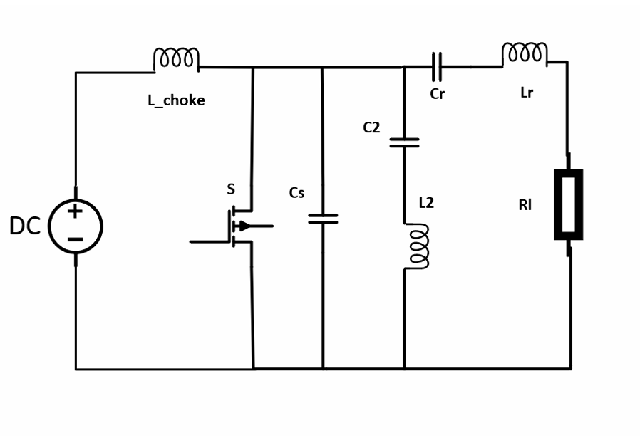
Circuit Diagram of Class EF2 Inverter

Slide 7
DC Supply and Feed Inductor (Lchoke):
A large RF choke connects the DC supply VDD to the drain. It provides high impedance at switching frequency, ensuring nearly constant current
CIRCUIT COMPONENTS AND OPERATION
Switching Device:
A MOSFET or GaN HEMT operates as a switch driven at frequency f0 with duty cycle D ≈ 0.4–0.5.
3.Shunt Capacitance (Cs):
This includes intrinsic capacitance Coss and shapes the voltage waveform, enabling ZVS

Slide 8
CIRCUIT COMPONENTS AND OPERATION
Second Harmonic Tank (L2 −C2):
This parallel resonant circuit is tuned to 2f0 and blocks second harmonic current, modifying the voltage waveform.
5. Load Network (Lr −Cr −RL):
A series resonant network tuned to f0 ensures sinusoidal current delivery to the load.

Slide 9
OPERATION OF CLASS EF2 INVERTER
On-State (0 ≤ ωt < 2πD)
The transistor conducts and vDS ≈ 0. Current flows through the switch.
Off-State(2πD≤ωt<2π) The switch is off,and the choke current charges the capacitance.The drain voltage rises and returns smoothly to zero.

Slide 10
ROLE OF SECOND HARMONIC TANK
The second-harmonic tank is tuned to:
f0=2f0
It confines second harmonic current and shapes the drain voltage waveform, reducing peak voltage. This reduces voltage stress from3.56VDD (Class E) to approximately2–3VDD.

Slide 11
MATHEMATICAL ANALYSIS AND DESIGN EQUATIONS

Slide 12
Assumption
1) The switching device operates as an ideal switch with zero on-resistance and infinite off-resistance.
2) The DC feed inductance L choke is sufficiently large so that the supply current Iin remains constant over a switching cycle.
3) The series load network(Lr–Cr–RL) has a high quality factor, ensuring sinusoidal output current at the fundamental frequency.
4) The shunt capacitance Cs is linear and constant, representing the transistor output capacitance.
5) All passive components are assumed lossless.

Slide 13
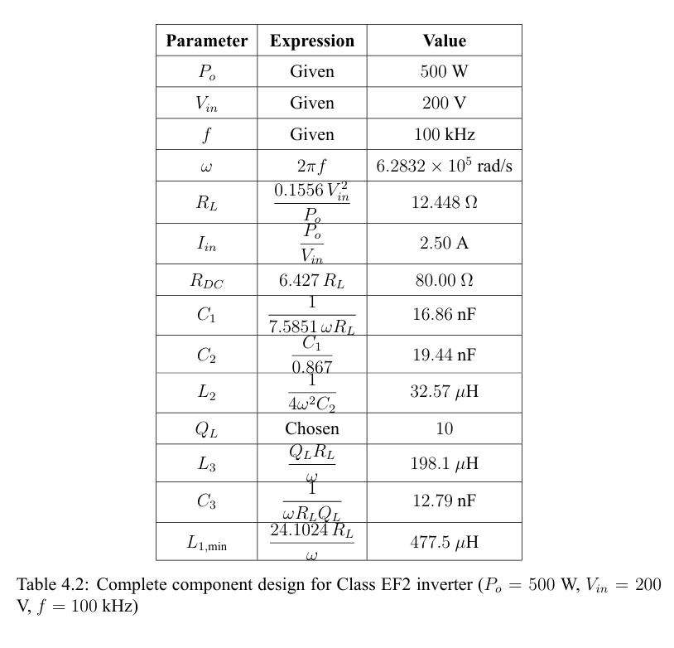

Slide 14
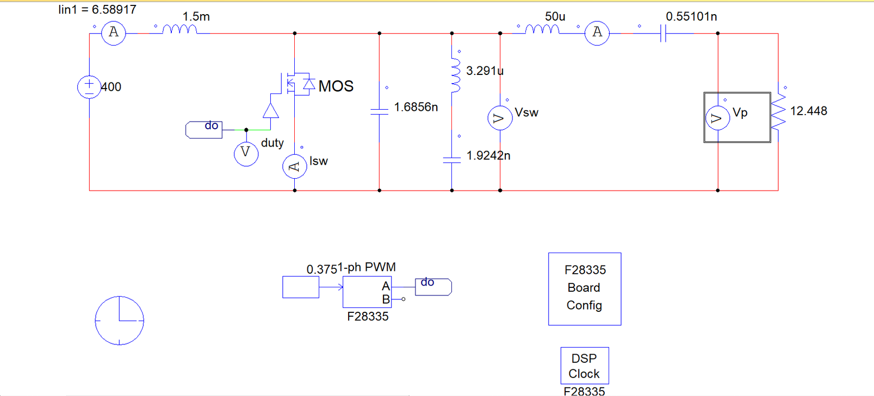
PSIM-based simulation model of the designed Class EF2 inverter using calculated component values

Slide 15
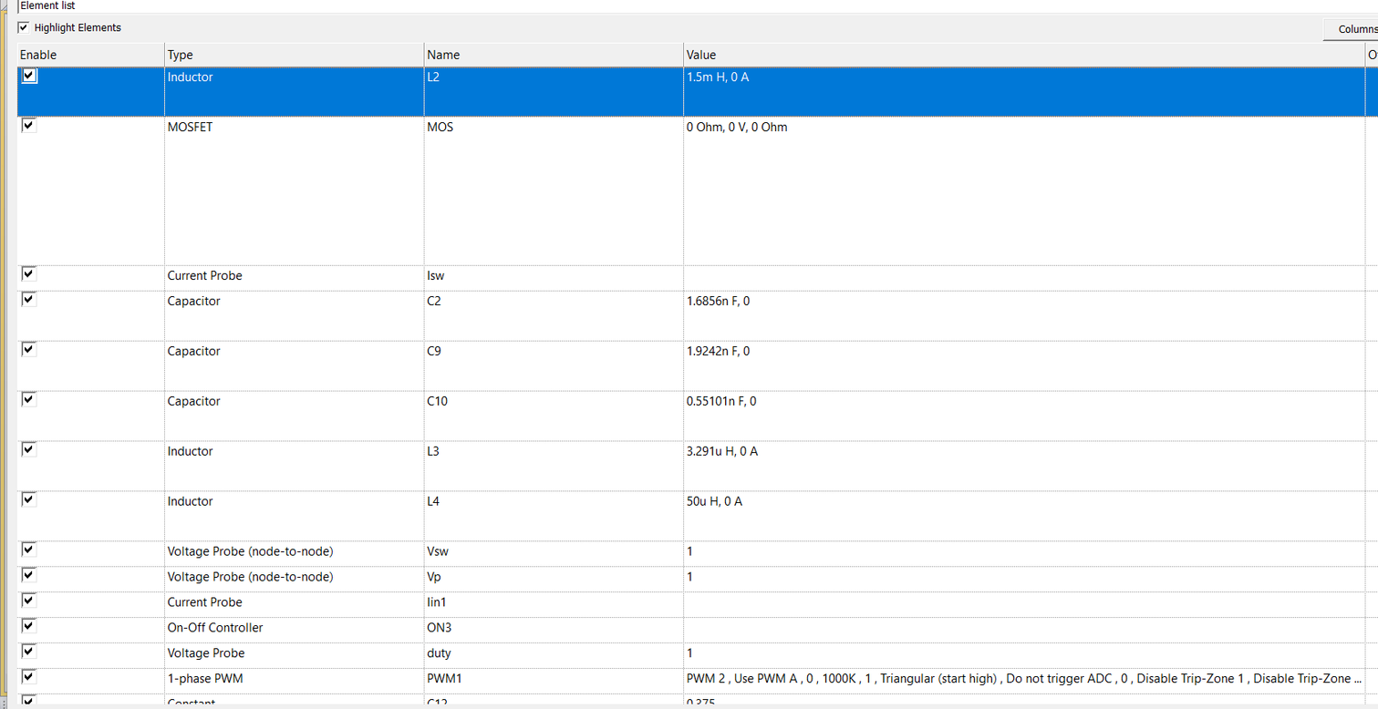
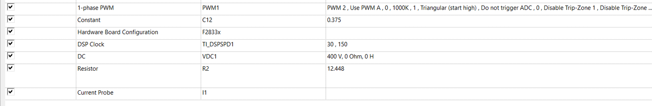
deatils of Elements used in simulation

Slide 16
SIMULATION RESULTS

Slide 17
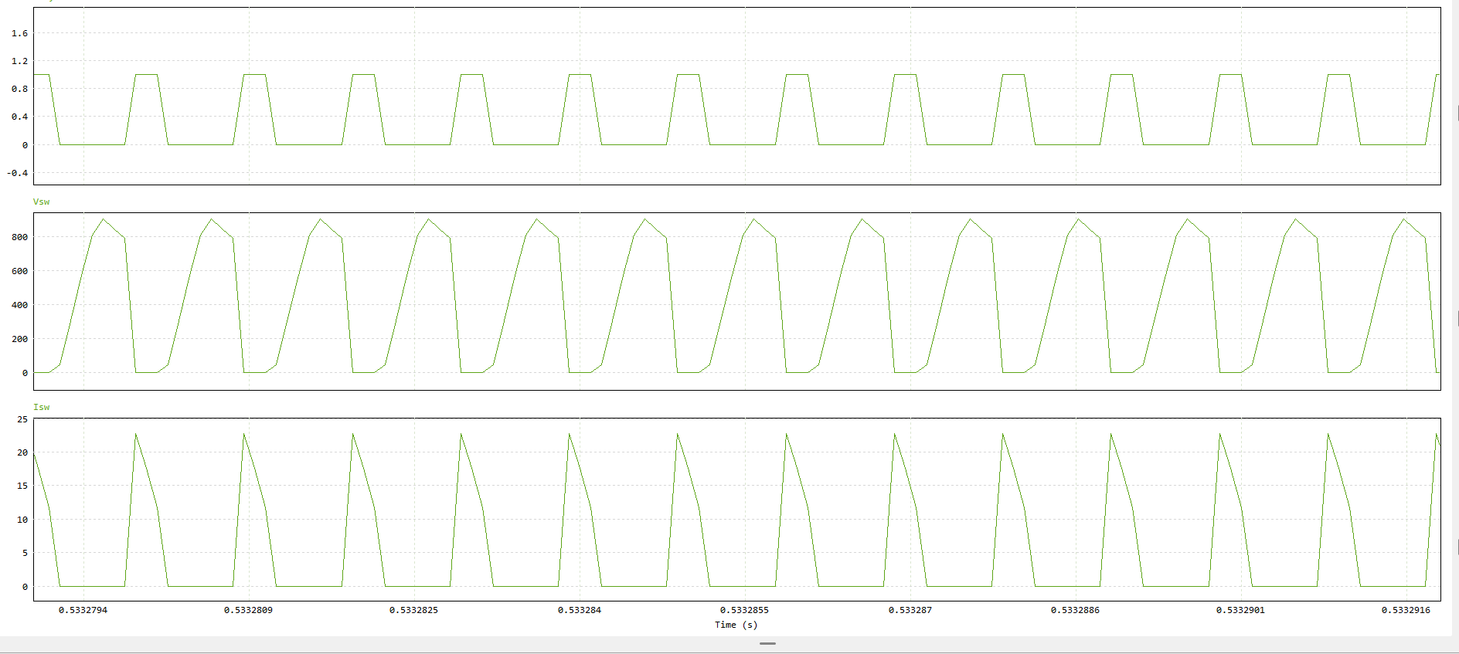
Output Waveform of Vsw and Isw

Slide 18
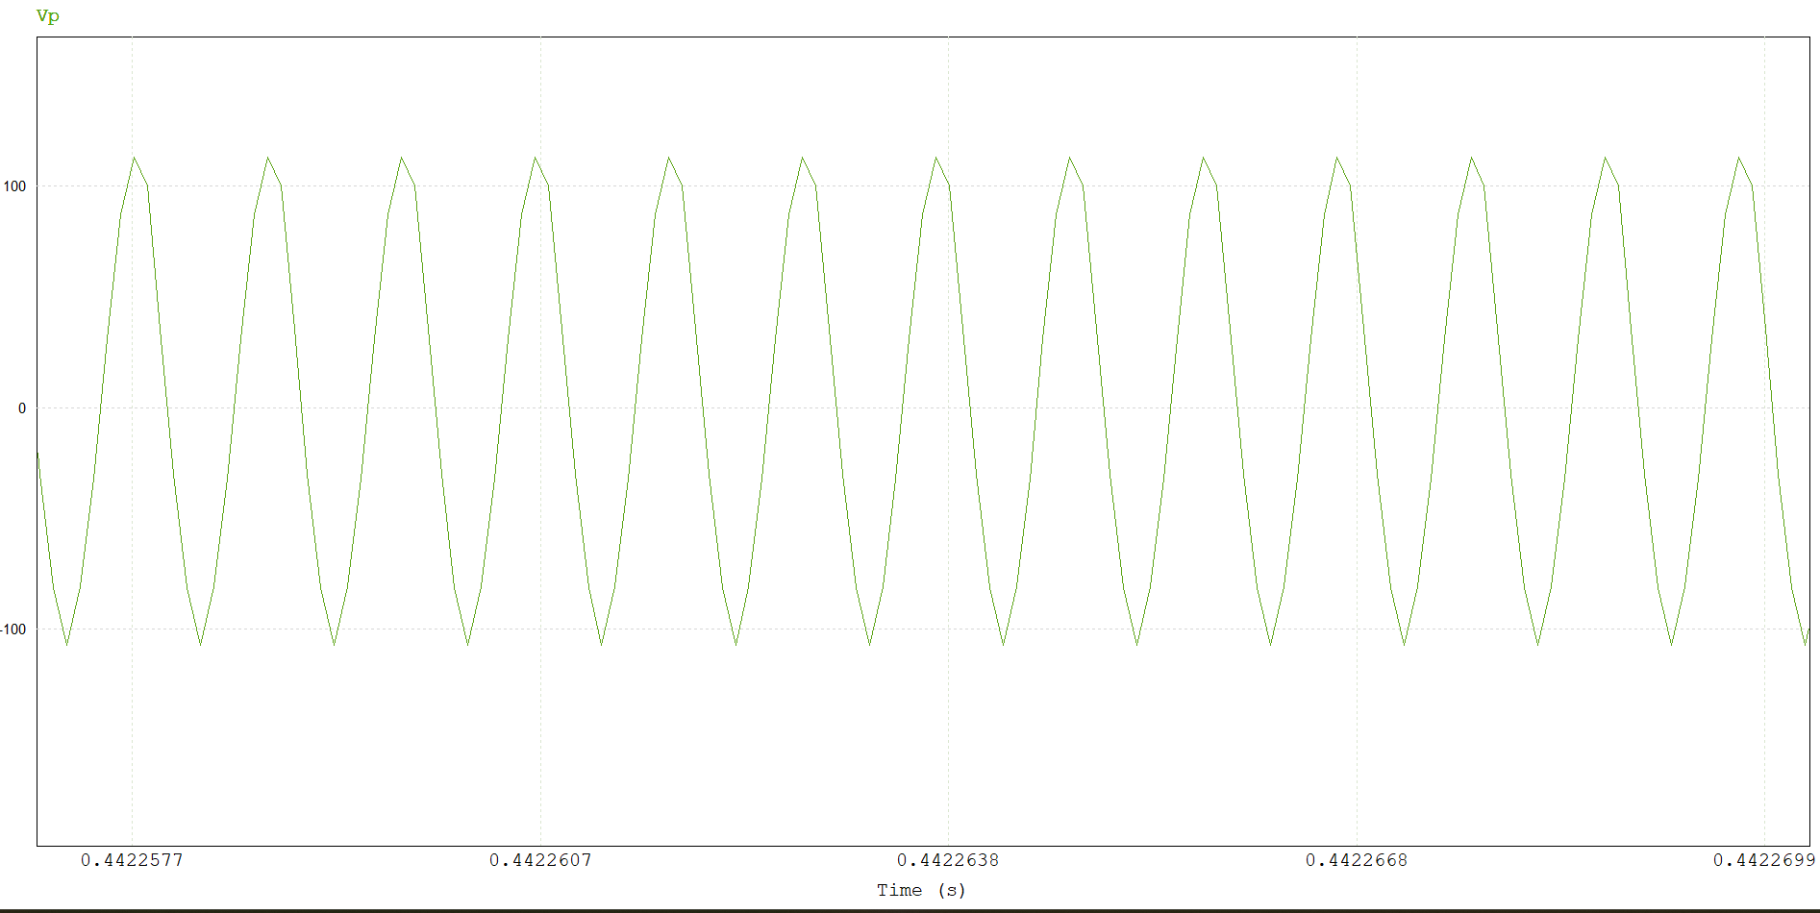
Output Voltage Waveform across the load

Slide 19
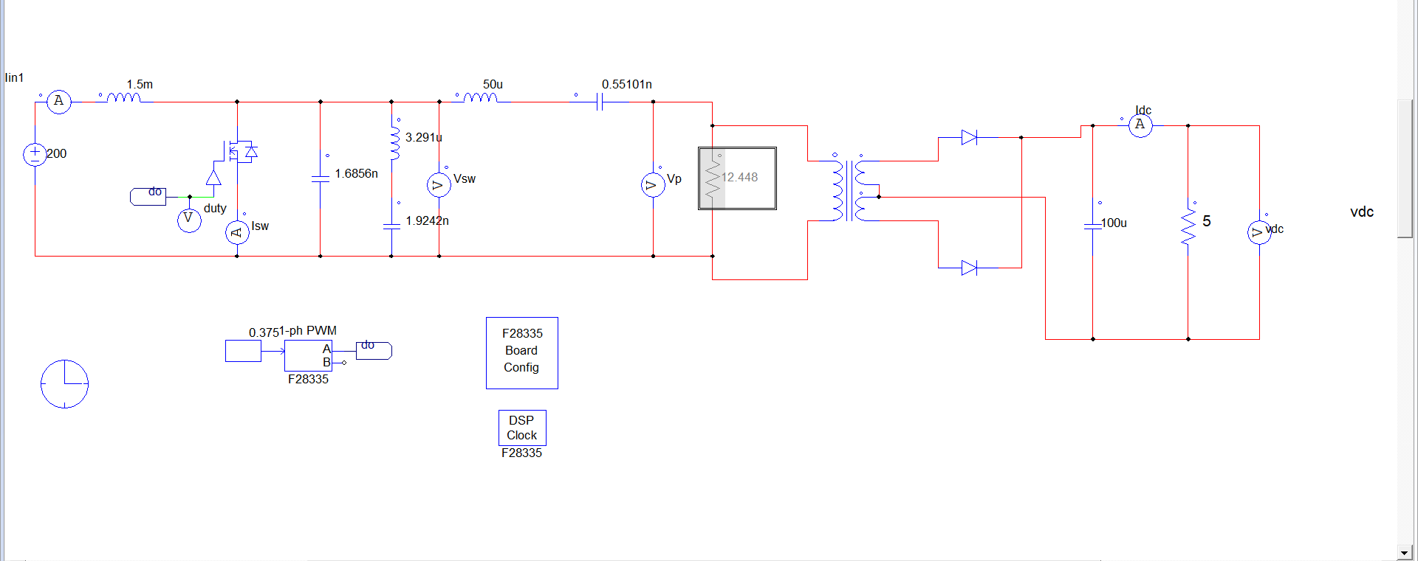
INVERTER POWER PROCESSING AND DC OUTPUT

Slide 20
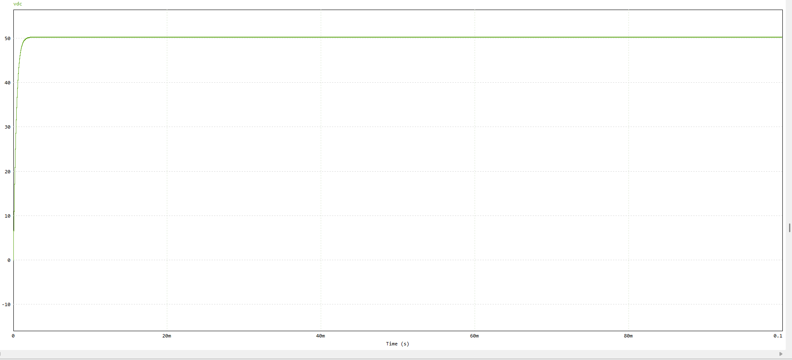
DC VOLTAGE OUTPUT

Slide 21
Conclusion
In this work, a Class EF2 inverter was successfully de signed, analyzed, and simulated.
The mathematical modeling provided a clear understanding of the operating principles and enabled accurate determination of component values.
The simulation results verified the theoretical analysis, demonstrating proper inverter operation and desired waveform characteristics.
The addition of a transformer and rectifier stage further validated the practical applicability of the system by producing a steady DC output across the load. Overall, the Class EF2 inverter offers improved performance in terms of efficiency and reduced switching stress, making it a suitable choice for high-frequency power conversion applications

Slide 22
Thank You!!

